Slide 1
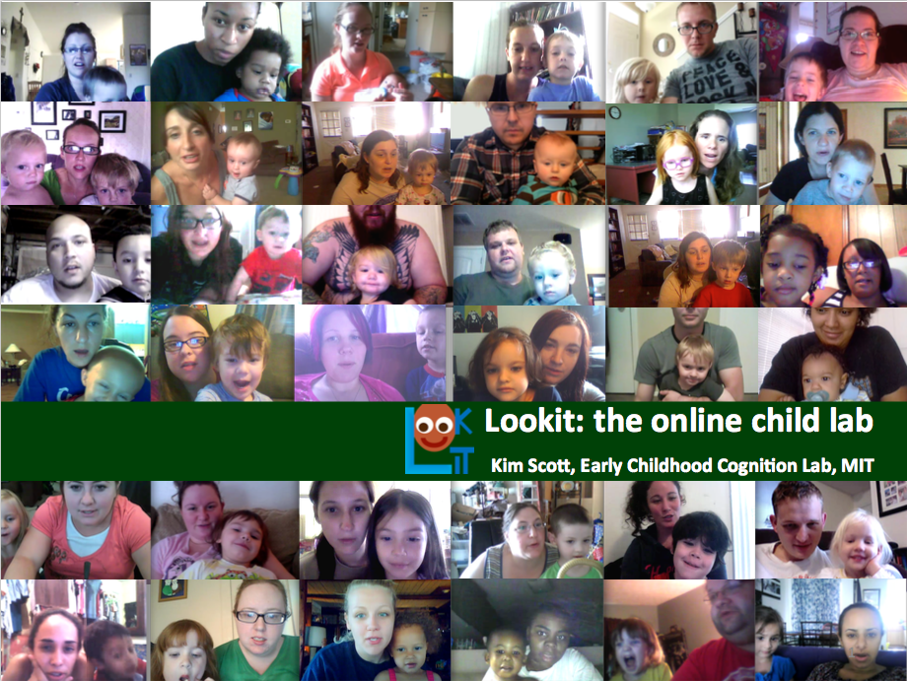





[Title]
[ Recruitment question ]
Come to lookit.mit.edu to participate in a new study— “[Title]”—from home!
[Study-specific picture]
[Study description / motivation]
[Study procedure]
Participate anytime – no appointments! Webcam video of your child’s responses will be analyzed by scientists to better understand how kids think and learn.
This research is conducted by Professor Laura Schulz and members of the Early Childhood Cognition Lab [in collaboration with researchers at …].

